Slide 1
DW-BI design ShopRite
MIS 636 Data Warehousing and Business Intelligence
Presented By
Abineshkumar Kumaravel
Aarthi Shunmugam
Anubhav Deep
Priyal Visaria
Mukul Thakker
Submitted To
Prof. Joseph Morabito
For Spring 2017 semester
Final Project

Slide 2
Overview
About ShopRite
Why DW-BI System?
Bus Matrix
Star Schema
Conformed Dimensions
Transformation Rules
Cube
Users and Tasks
Dashboards/Visualizations
Conclusion

Slide 3
About ShopRite
ShopRite is a chain of supermarkets doing business in various states of the Eastern part of USA (Connecticut, Delaware, NJ, NY, Maryland, Pennsylvania)
From a small, struggling cooperative with eight Members – all owners of their own grocery stores – Wakefern Food Corp., the merchandising and distribution arm for ShopRite, has grown into the largest retailer-owned cooperative in the United States and the largest employer in New Jersey.
Headquartered in Keasbey, New Jersey, Wakefern operates over 2.5 million square feet of grocery and non-food warehousing. Its transportation fleet, one of the largest private fleets on the east coast, consists of 400 tractors and 2,000 trailers, and travels more than 35 million miles annually.

Slide 4
Why DW & BI system?
ShopRite competes with bigger brands by manufacturing substitute products
A DW & BI system will help:-
Analyze their business and maximizing profits
Managing inventory of products
Make better decision making at all levels
Cleverly decide on product substitutes
Manage promotions and sales
Dashboards/Visualizations to better monitor daily activities

Slide 5
Business Process
 | Date & Time | Vendor | Product | Logistics | Transaction | Customer | Media | Service Policy | Status & Type | Transport
Procurement | X | X | X | X | X |  |  |  | X | X
Manufacturing | X | X | X | X |  |  |  |  | X | X
Sales | X | X | X | X | X | X | X | X | X
Inventory | X |  | X | X |  |  |  |  | X | X
HR | X |  |  |  |  |  |  | X | X
Accounts | X | X | X |  | X | X |  |  | X
Payroll | X | X |  |  |  | X | X | X | X | X
Marketing | X |  | X |  |  | X | X | X
Customer Servives | X |  | X |  |  | X |  | X | X
Infrastructure and Operations | X | X | X | X |  |  |  |  | X | X

Slide 6
Opportunity Matrix
Business Processes | Customer Service | Financial | Operations | Human Resource | Marketing | Strategy Management
In Store Sales Transaction | x | x | x | x | x | x
Online Sale Transaction | X | x | x | x |  | x
Vendor Sales Transaction |  | x |  |  | x
Order Processing |  |  | x
Delivery Process |  |  | x
Return Policy |  | x |  |  | x

Slide 7
Prioritization Grid
High
BP1
BP4
BP2
Business value
BP3
BP5
BP6
Low
Low
High
Feasibility

Slide 8
High Level Bus Matrix
Business Processes | Date and Time | Product | Customer | Location | Service Policy | Employees | Vendors | Promotions | Transactions
In-store Sales | x | x | x | x |  | x |  | x | x
Vendor Sales Transaction | X | x | x | x |  |  | X |  | x
Order Processing | x | X | x | x | X | x
Delivery | x | x | x | x | x
Return Policy | x | x |  | x | x

Slide 9
Detailed High Level Bus Matrix
Business Process | Fact tables | Granularity | Fact | Date | Product | Customer | Location | Service policy | Employees | Vendor | Transaction | Promotions
In-store Sales Transaction | Sales transaction | Per line item | purchase date key purchase amount key purchase unit price key transaction number | x | x | x | x |  | x |  | x | x
 | Location | Per location | Store key Location key Area key | x | x |  | x
Vendors Sales Transaction | Sales transaction | Per line item | purchase date key purchase amount key purchase unit price key transaction number | x | x | x | x |  | x | x | x
 | Vendor information | Per Vendor | Vendor key Vendor item key | x | x | x | x |  | x | x
Order Processing | warehouse picking | Per warehouse receipt | ship date key requested date key product key vendor key | x | x | x |  | x
 | billing and invoicing | Per order | date key order number quantity key product key … | x | x | x |  |  | x
Delivery Process | shipping notice | Per line item | shipping date key shipping cost key tracking number delivery company key …. | x | x | x | x | x
 | delivery operation | Per line item | tracking number shipping date delivery cost key …. | x | x |  | x | x
Return Policy | store return process | Per line item | store number key item number key return date key …. | x | x |  | x | x | x
 | mail return process | Per line item | tracking number return date key | x | x | x |  | x

Slide 10
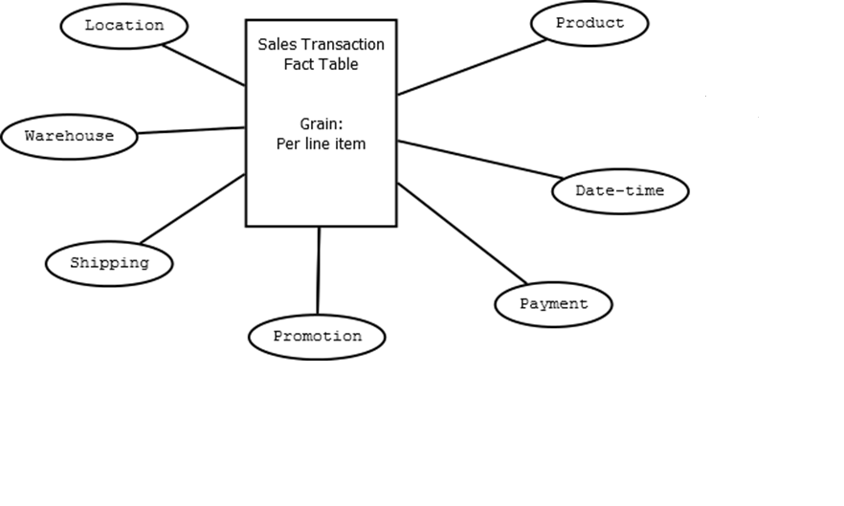
Logical Schema

Slide 11
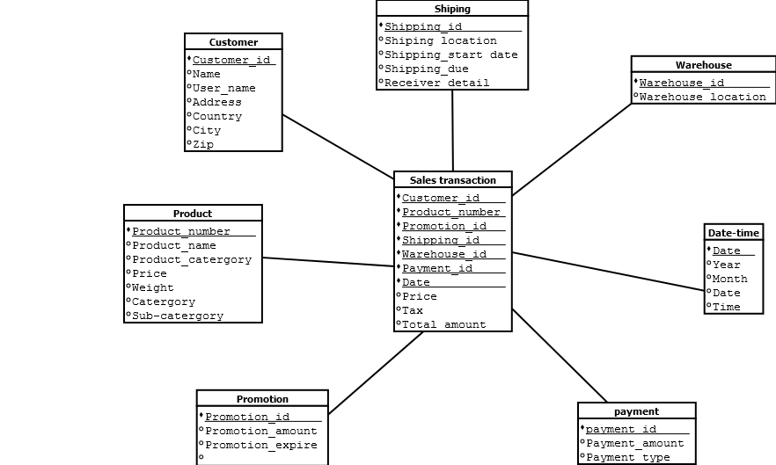
Physical Star Schema

Slide 12
Product Table – Original Table
Sales Transaction | Product ID |  |  |  | Location |  |  |  | Time
 | Product 1 |  | Product 2 |  | UNITED STATES |  |  |  | Year1 |  |  |  | Year2
 | Product ID 1 | Product Name 1 | Product ID 2 | Product Name 2 | State 1 |  | State 2 |  | Quarter 1 |  | Quarter 2 |  | Q1 | Q2
 |  |  |  |  | County 1 | County 2 | County 1 | County 2 | Month 1 |  | Month 2 |  | M1 | M2
 |  |  |  |  |  |  |  |  | D1 | D2 | D1 | D2 | D1 | D2
Product No
Warehouse ID
Promotion ID
Date Key
Total Price
Total Amount

Slide 13
Aggregate Table
Sales Transaction | Product ID |  |  |  | Location |  |  |  | Time
 | Product 1 |  | Product 2 |  | UNITED STATES |  |  |  | Year1 |  |  |  | Year2
 |  |  |  |  | State 1 |  | State 2 |  | Quarter 1 |  | Quarter 2 |  | Q1 | Q2
 |  |  |  |  |  |  |  |  | M1 M2 |  | M1 M2 |  | ….. | …..
Product No
Warehouse ID
Promotion ID
Date Key
Total Price
Total Amount

Slide 14
Aggregate Table
Sales Transaction | Product ID |  |  |  | Location |  |  |  | Time
 | Product 1 |  | Product 2 |  | UNITED STATES |  |  |  | Year1 |  |  |  | Year2
 |  |  |  |  | State 1 |  | State 2 |  | Quarter 1 |  | Quarter 2 |  | Q1 | Q2
Product key
Warehouse ID
Promotion ID
Date Key
Total Price
Total Amount

Slide 15
Transformation Rules
Attribute | Rule Type | Details
Currency amount | Formula | Used latest rate to pay in other currency
Sales Date and Time | Replace | Transform data format from DDMMYYYY to MMDDYYYY and reverse
Total Sales | Formula | This transformation will find sum of all sales
Total Price | Formula | Summation of cost of all products purchased and Sales tax
Promotion Sales | Formula | Derive amount by reducing promoted sale discount
Sales Tax | Formula | Tax of X% added to total price to derive final amount

Slide 16

OLAP Cube
Product 1
Product 2
Product 3
Quarter 1
Quarter 2
State 1
State 2
State 3
Quarter 3

Slide 17
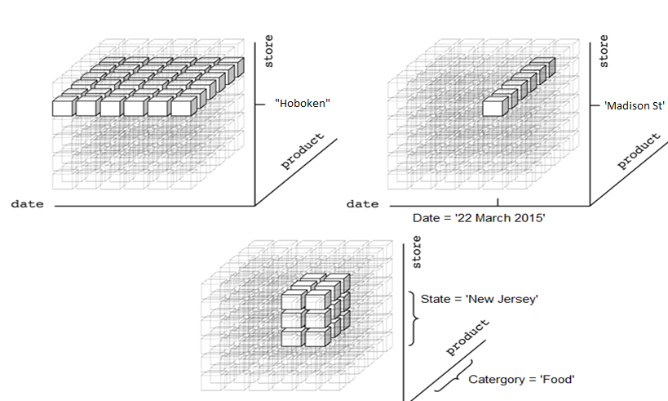
OLAP Cube Operations

Slide 18
Users and Tasks
Financial/Management
Custom visualizations/reports to view region-wise activities regarding sales, revenue
Monitor customer satisfaction, customer loyalty, quarterly profits/ losses
Business Analyst
Custom dashboards to monitor product details and recommend for new product
Analyze trends and purchase patterns and make recommendations
Risk Analyst
Monitor for below par product sales using visualization
Recommend solution to a avert risks and increase profitability
Analyst
View standardized reports for daily store activity, purchases, new customers
Operational Analyst
View visualizations to manage inventory count and predict future sales

Slide 19
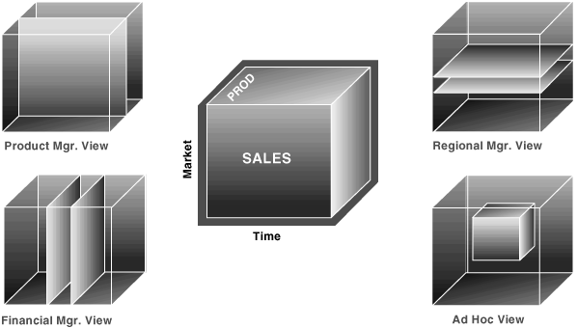
Views for different users

Slide 20
DW-BI System – Access Methods
Users | Type of Access
Finance/Management | Full OLAP cube and customized dashboard
Business Analyst | Full OLAP cube and customized dashboard
Risk Analyst | Full OLAP cube and customized dashboard
Analyst | Daily standardized reports
Operational Analyst | Custom reports and customized dashboard

Slide 21
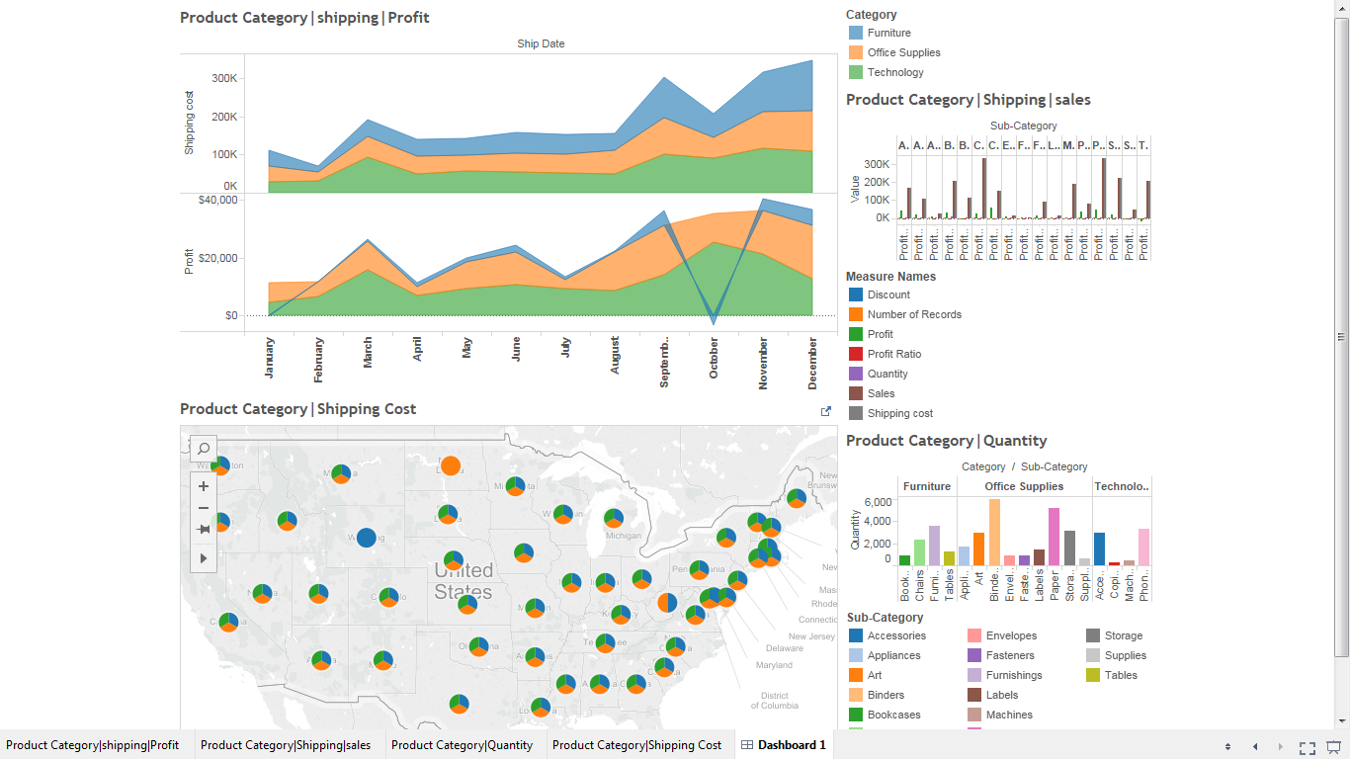
Financial Analyst Dashboard

Slide 22
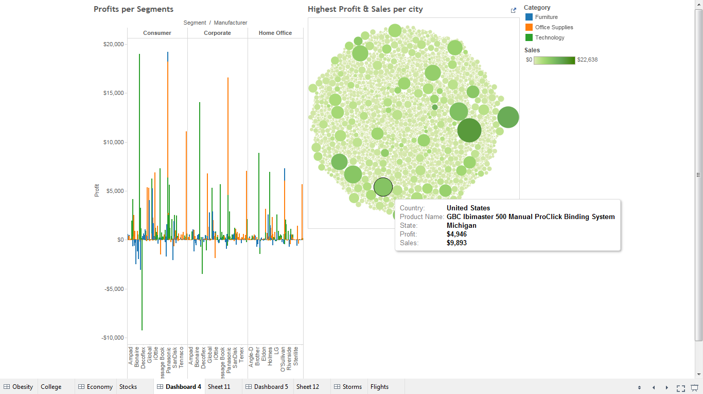
Business Analyst Dashboard

Slide 23
Conclusion
This BI & DW system will help ShopRite analyze their day to day business and proceedings
The statistics will add value to the organization and help the top management in making better decisions
The dashboard tools integrated with OLAP queries will give a different dimension in viewing data thus aiding decision making

Slide 24
Thank you!

